Slide 1


Unit-02 Object Oriented Concepts
Object Oriented Programming (OOP)
(2101CS203)
Prof. Arjun V. Bala
Computer Engineering Department
arjun.bala@darshan.ac.in
9624822202

Slide 2

Outline
Class
Object
Object Oriented Concepts
Encapsulation
Inheritance
Polymorphism
Abstraction
Object Reference
Methods
Method Overloading
Constructor
Constructor Overloading
Recursion
Passing and Returning Object
this keyword
static keyword
Access control
Nested class / Anonymous inner class
String Class
StringBuffer Class
Math Class
Wrapper Classes
Looping

Slide 3
Class
Class is derived datatype, it combines members of different datatypes into one.
Defines new datatype (primitive ones are not enough).
For Example : Car, College, Bus etc..
This new datatype can be used to create objects.
A class is a template for an object .
Example :
class Car{
String company;
String model;
double price;
double mileage;
………
}

Slide 4

Car Class
Class: Car
Properties (Describe)
Company
Model
Color
Mfg. Year
Price
Fuel Type
Mileage
Gear Type
Power Steering
Anti-Lock braking system
Methods (Functions)
Start
Drive
Park
On_break
On_lock
On_turn

Slide 5
Object
An object is an instance of a class.
An object has a state and behavior.
Example: A dog has
states - color, name, breed as well as
behaviors – wagging the tail, barking, eating.
The state of an object is stored in fields (variables), while methods (functions) display the object's behavior.

Slide 6

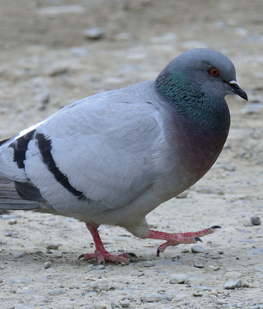
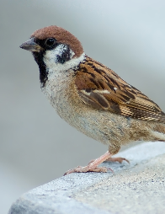


Objects of Class Bird

Slide 7





Objects of a class Car
Honda City
Hyundai i20
Sumo Grand
Mercedes E class
Swift Dzire

Slide 8
Rectangle Class
Properties in rectangle Class
length
width
borderColor
backgroundColor
length = 5
width = 2
borderColor=black
backgroundColor=white
length = 2
width = 5
borderColor=black
backgroundColor=white
length = 3
width = 3
borderColor=red
backgroundColor=white
length = 5
width = 2
borderColor=none
backgroundColor=yellow

Slide 9



Attributes and operations
Attributes:
Name
Age
Weight
Attributes:
Company
Model
Weight
Attributes:
AccountNo
HolderName
Balance
Operations:
Eat
Sleep
Walk
Operations:
Drive
Stop
FillFuel
Operations:
Deposit
Withdraw
Transfer
Write down 5 objects with its attributes and operations

Slide 10
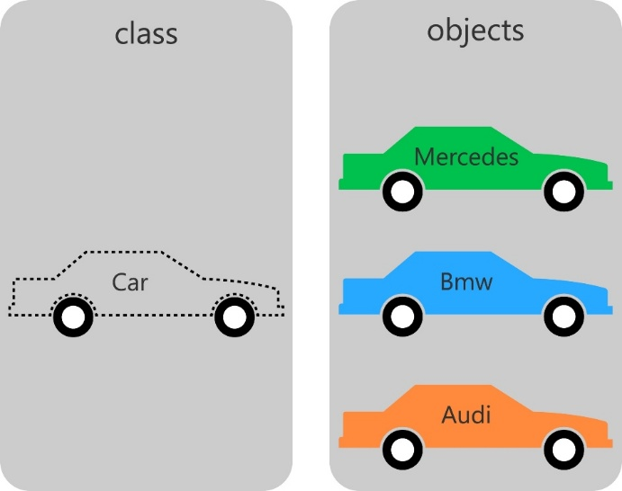
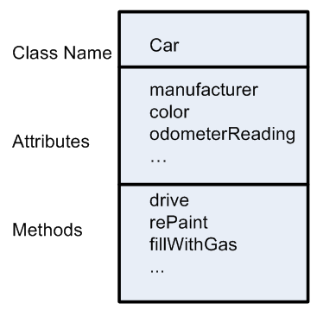
Class

Slide 11
Procedural Vs. Object Oriented Programming
POP | OOP
Emphasis is on doing things not on data, means it is function driven | Emphasis is on data rather than procedure, means object driven
Main focus is on the function and procedures that operate on data | Main focus is on the data that is being operated
Top Down approach in program design | Bottom Up approach in program design
Large programs are divided into smaller programs known as functions | Large programs are divided into classes and objects
Most of the functions share global data | Data is tied together with function in the data structure

Slide 12
Procedural Vs. Object Oriented Programming
POP | OOP
Data moves openly in the system from one function to another function | Data is hidden and cannot be accessed by external functions
Adding of data and function is difficult | Adding of data and function is easy
Concepts like inheritance, polymorphism, data encapsulation, abstraction, access specifiers are not available. | Concepts like inheritance, polymorphism, data encapsulation, abstraction, access specifiers are available and can be used easily
Examples: C, Fortran, Pascal, etc… | Examples: C++, Java, C#, etc…

Slide 13
OOPs Concept
4 pillars that makes language Object Oriented Programming language.
OOP
Encapsulation
Inheritance
Abstraction
Polymorphism

Slide 14

Encapsulation
The wrapping up of data and functions into a single unit is known as encapsulation
The insulation of the data from direct access by the program is called data hiding or information hiding.
It is the process of enclosing one or more details from outside world through access right.
In simple words, "Encapsulation is a process of binging data members (variable, properties) and member functions (methods) into a single unit.

Slide 15
Inheritance
The mechanism of deriving a new class from an old class is called inheritance or derivation.
The old class is known as base class while new class is known as derived class or subclass.
It lets programmers create new classes that share some of the attributes of existing classes.
Inheritance lets us build on previous work without reinventing the wheel.
The inheritance is the most powerful feature of OOP.
Through effective use of inheritance, we can save lot of time in programming and also reduce errors, which in turn will increase the quality of work and productivity.
Employee
Manager
Worker
- ID
- Name
- Address
- Contact
- ID
- Name
- Address
- Contact
- MonthlySalary
- ID
- Name
- Address
- Contact
- DailySalary
- NoOfHours

Slide 16
Another Example of Inheritance
Vehicle
noOfPassanger
maxSpeed
noOfWheels
noOfGears
noOfPassanger
maxSpeed
noOfWheels
noOfGears
noOfPassanger
maxSpeed
noOfWheels
noOfGears
noOfPassanger
maxSpeed
noOfWheels
noOfGears
Inheritance
Inheritance
Inheritance
Bike
cubicCapacity
isMoped
Bike
cubicCapacity
isMoped
Car
horsePower
noOfAirBags
tollTaxAmount()
Car
horsePower
noOfAirBags
tollTaxAmount()
Truck
horsePower
loadingCapacity
payTollTax()
Truck
horsePower
loadingCapacity
payTollTax()

Slide 17
Abstraction
Abstraction refers to the act of representing essential features without including the background details or explanations.
Abstraction provides you a generalized view of your classes or object by providing relevant information.
Abstraction is the process of hiding the working style of an object, and showing the information of an object in understandable manner.
Example:
Electric Switch Board: we need not to worry about the internal work of switch board in order to use it, simply switch on/off to start/stop the device.
Car: you need not to understand how engine works in order to drive a car, you just need to know how to drive the car.
TV Remote: while increasing the TV volume you need not to understand the underlying process, just press the + volume button and it will work.

Slide 18

Polymorphism
Polymorphism is a Greek term which means ability to take more than one form.
A person at the same time can have different characteristics. Like a man at the same time is a father, a husband, an employee. So the same person possesses different behavior in different situations. This is called polymorphism.

Slide 19
Creating Object & Accessing members
new keyword creates new object
Syntax:
ClassName objName = new ClassName();
Example :
SmartPhone iPhone = new SmartPhone();
Object variables and methods can be accessed using the dot (.) operator
Example:
iPhone.storage = 8000;

Slide 20
class Box {
double length;
double breadth;
double height;
}
class BoxDemo {
public static void main(String args[]) {
Box myBox1 = new Box();
Box myBox2 = new Box();
double vol;
myBox1.length = 10;
myBox1.breadth = 20;
myBox1.height = 30;
myBox2.length = 3;
myBox2.breadth = 6;
myBox2.height = 9;
vol = myBox1.length * myBox1.breadth * myBox1.height;
System.out.println("Volume is " + vol);
vol = myBox2.length * myBox2.breadth * myBox2.height;
System.out.println("Volume is " + vol);
}
}
length = 10
length
myBox1
breadth = 20
breadth
height = 30
height
length
length = 3
myBox2
breadth = 6
breadth
height = 9
height

Slide 21
Introducing methods
Methods represents the behavior of a class.
Remember : a Method is always invoked relative to an object. (except ….)
Syntax:
access_specifier return_type method_name(argument_list)
{
// code
}

Slide 22
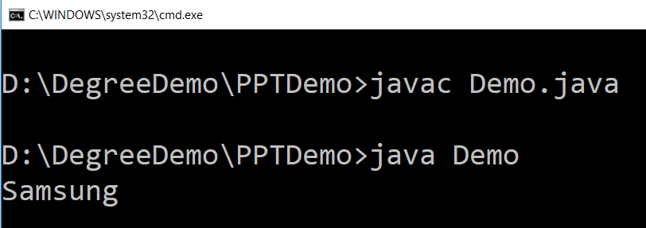
Example (method)
public class SmartPhone {
String manufacturer;
String model;
double storage;
double screenSize;
public String getManufacturer(){
return manufacturer;
}
public void setManufacturer(String a){
manufacturer = a;
}
}
public class Demo {
public static void main(String args[]) {
SmartPhone sp = new SmartPhone();
sp.setManufacturer("Samsung");
String name = sp.getManufacturer();
System.out.println(name);
}
}

Slide 23
Constructor
A constructor is a “special” member method which initializes the objects of class.
Properties of constructor:
Constructor is invoked automatically whenever an object of class is created.
Constructor name must be same as class name.
Constructors do not have return types and they cannot return values, not even void.
All classes have constructors by default: if you do not create a class constructor yourself, Java creates one for you. However, then you are not able to set initial values for object attributes.
Types of Constructor
Default Constructor
Parameterized Constructor

Slide 24
Default Constructor
Default constructor is the one which invokes by default when object of the class is created.
It is generally used to initialize the default value of the data members.
It is also called no argument constructor.
class Rect{
int len;
int wid;
boolean isFilled;
public Rect(){
len = 6;
wid = 6;
isFilled = false;
}
}
public class RectDemo{
public static void main(String[] args) {
Rect r1 = new Rect();
System.out.println(r1.len);
}
}

Slide 25
Parameterized Constructor
Constructors that can take arguments are called parameterized constructors.
Sometimes it is necessary to initialize the various data elements of different objects with different values when they are created.
We can achieve this objective by passing arguments to the constructor when the objects are created.
class Rect{
int len;
int wid;
boolean isFilled;
public Rect(int l, int w, boolean isF){
len = l;
wid = w;
isFilled = isF;
}
}
public class RectDemo{
public static void main(String[] args) {
Rect r1 = new Rect(6,6,false);
System.out.println(r1.len);
}
}

Slide 26
this keyword
this is a reference variable that refers to the current object.
this can be used to invoke current object's method.
this() can be used to invoke current class constructor
this can be passed as a parameter to constructor and method call.
this can be used to return the current object from the method.

Slide 27
class Box {
double length;
double breadth;
double height;
Box(double l, double b, double h) {
System.out.println("Constructing Box");
length = l;
breadth = b;
height = h;
}
void volume() {
double volume = length * breadth * height;
System.out.println("Volume is " + volume);
}
}
class BoxDemo {
public static void main(String args[]) {
Box myBox1 = new Box(10,20,30);
Box myBox2 = new Box(3,6,9);
myBox1.volume();
myBox2.volume();
}
}
Box(double length, double breadth, double height) {
this.length = length;
this.breadth = breadth;
this.height = height;
length = length;
breadth = breadth;
height = height;
length is instance variable as well as length is formal parameter of method
Creates ambiguity for compiler

Slide 28
Understanding the Scope of Variable

Slide 29
Method Overloading
public class OverloadingMethods {
public static void main(String[] ar) {
int ans1 = sum(5,2); // will return 7
int ans2 = sum(5,2,6); // will return 13
double ans3 = sum(5.8,6.4); // will return 12.2
// print ans1,ans2,ans3 in order to see the result
}
// Overloaded sum(). This sum takes two int parameters
public static int sum(int x, int y) {
return (x + y);
}
// Overloaded sum(). This sum takes three int parameters
public static int sum(int x, int y, int z) {
return (x + y + z);
}
// Overloaded sum(). This sum takes two double parameters
public static double sum(double x, double y) {
return (x + y);
}
}
Overloading allows different methods to have same name, but different signatures.
Signature can differ by number of input parameters or type of input parameters or both.
Overloading is related to compile time (or static) polymorphism.

Slide 30
static keyword
static keyword is mainly used for memory management.
It can be used with
Variables
Methods
Blocks
Nested classes
Basically, static is used for a constant variable or a method that is same for every instance of a class.
The static variable can be used to refer to the common property of all objects.
The static variable gets memory only once in the class area at the time of class loading.
It makes your program memory efficient.
Syntax
static type variablename;

Slide 31
class Student {
int rollNo;
String name;
.
.
.
}
static String college = "DIET";
String college = "DIET";
class StudentDemo {
public static void main(String args[]) {
Student student1 = new Student();
Student student2 = new Student();
Student student3 = new Student();
.
.
.
}
}
student1
student2
student3
rollNo
name
college
DIET
DIET
DIET
college
DIET

Slide 32
static method
If you apply static keyword with any method, it is known as static method.
A static method belongs to the class rather than the object of a class.
A static method can be invoked without the need for creating an instance of a class.
A static method can access static data member and can change the value of it.
Restrictions
The static method can not use non static data member or call non-static method directly.
this and super cannot be used in static context.

Slide 33
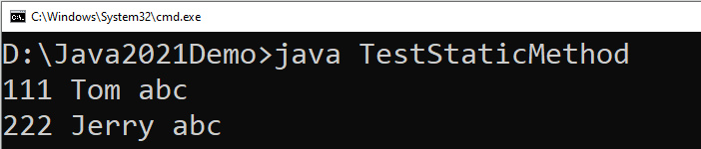
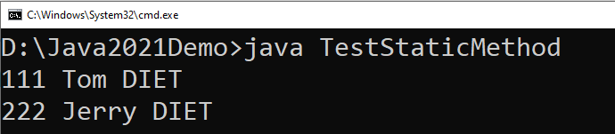
class Student {
int rollno;
String name;
static String college="abc";
static void change() {
college = "DIET";
rollno = 10;
}
Student(int r, String n) {
rollno = r;
name = n;
}
void display() {
System.out.println(rollno+" "+name+" "+college);
}
}
class TestStaticMethod {
public static void main(String args[]) {
Student.change();
Student s1 = new Student(111,"Tom");
Student s2 = new Student(222,"Jerry");
s1.display();
s2.display();
}
}
We can not use non-static variables in static methods

Slide 34
static block
static block is executed exactly once, when the class is first loaded.
It is used to initialize static variables of the class.
It will be executed even before the main method.
Syntax:
static {
//initialisation of static variables…
}

Slide 35
Mutable and Immutable
The content of mutable object can be changed, while content of immutable objects can not be changed.
class MutableClass{
int a;
void add5() {
a = a + 5;
}
}
public class MutableClassDemo {
public static void main(String[] args) {
MutableClass m1 = new MutableClass();
m1.a = 10;
m1.add5();
System.out.println(m1.a);
}
}
class ImmutableClass{
int a;
int add5() {
return ( a + 5 );
}
}
public class MutableClassDemo {
public static void main(String[] args) {
ImmutableClass m1 = new ImmutableClass();
m1.a = 10;
int ans = m1.add5();
System.out.println("A in m1 = " + m1.a);
System.out.println("returned = " + ans);
}
}

Slide 36
Passing Objects as Argument
In order to understand how and why we need to pass object as an argument in methods, lets see the below example.
class Time{
int hour;
int minute;
int second;
public Time(int hour, int minute, int second) {
this.second = second;
this.minute = minute;
this.hour = hour;
}
void add(Time t) {
this.second += t.second;
if(this.second>=60) {
this.minute++;
this.second-=60;
}
this.minute += t.minute;
if(this.minute>=60) {
this.hour++;
this.minute-=60;
}
this.hour += t.hour;
}
}
public class TimeDemo {
public static void main(String[] args) {
Time t1 = new Time(11,59,55);
Time t2 = new Time(0,0,5);
t1.add(t2);
System.out.println(t1.hour + ":" + t1.minute + ":" + t1.second);
}
}

Slide 37
Array of Objects
We can create an array of object in java.
Similar to primitive data type array we can also create and use arrays of derived data types (class).
class Student{
int rollNo;
String name;
public Student(int rollNo, String name) {
this.rollNo = rollNo;
this.name = name;
}
void printStudentDetail() {
System.out.println("| "+
rollNo
+" | -- | "+
name +" |");
}
}
public class ArrayOfObjectDemo {
public static void main(String[] args) {
Student[] stu = new Student[3];
stu[0] = new Student(101,"darshan");
stu[1] = new Student(102,"arjun");
stu[2] = new Student(103,"java");
stu[0].printStudentDetail();
stu[1].printStudentDetail();
stu[2].printStudentDetail();
}
}

Slide 38
Package (Topic from Unit-07)
A Package can be defined as a grouping of related types providing access protection and name space management.
Programmers can define their own packages to bundle group of classes/interfaces, etc.
Packages are used in Java in order to
prevent naming conflicts
control access,
make searching/locating of classes/interfaces easier.
It is a good practice to group related classes implemented so that a programmer can easily determine that the classes, interfaces are related.

Slide 39
Creating a package
To create a package you need to write package statement followed by the name of the package.
Syntax : package package_name;
Example :
The package statement should be the first line in the source file.
There can be only one package statement in each source file, and it applies to all types in the file.
If a package statement is not used then the class/interfaces will be put into an unnamed package.
package darshan_student;
class Student {
// code
}

Slide 40
Package (Example)
To compile
javac –d . Animal.java
To Run the class file
java myPackage.Animal
package myPackage;
public class Animal {
public String name;
public void eat(){
System.out.println("Organic Food !!!!");
}
public static void main(String[] args){
Animal a = new Animal();
a.eat();
}
}
.
Represent the current directory

Slide 41
import keyword
import keyword is used to import built-in and user-defined packages into your java source file so that your class can refer to a class that is in another package by directly using its name.
There are 3 different ways to refer to class/interface that is present in different package
import the class/interface you want to use.
import all the classes/interfaces from the package.
Using fully qualified name.
We can import a class/interface of other package using a import keyword at the first line of code.
Example :
import java.util.Scanner;
public class DemoImport {
public static void main(String[] args)
{
Scanner s = new Scanner(System.in);
// Code
}
}

Slide 42
import (importing all class/interface)
We can import all the classes/interfaces of other package using a import keyword at the first line of code with the wildcard (*).
Example :
It is possible to use classes from other packages without importing the class using fully qualified name of the class.
Example :
import java.util.*;
public class DemoImport {
public static void main(String[] args)
{
Scanner s = new Scanner(System.in);
Date d = new Date();
// Code
}
}
java.util.Scanner s = new java.util.Scanner(System.in);

Slide 43
Static Import
The static import feature of Java 5 facilitate the java programmer to access any static member of a class directly.
Advantage : Less coding is required if you have to access any static member of a class more frequently.
Disadvantage : If you overuse the static import feature, it makes the program unreadable and unmaintainable.
import static java.lang.System.out;
public class S2{
public static void main(String args[]){
out.println("Hello main");
}
}
We need not to write System.out as we have imported the out statically

Slide 44
Access Control
Modifier | Same Class | Same Package Sub Class | Same Package Non Sub Class | Different Package Sub Class | Different Package Non Sub Class
Private
Default
Protected
Public

Slide 45
Nested Class
The Java programming language allows you to define a class within another class. Such a class is called a nested class and is illustrated here
Nested classes are divided into two categories: non-static and static.
Non-static nested classes are called inner classes.
Nested classes that are declared static are called static nested classes.
A nested class is a member of its enclosing class.
Non-static nested classes (inner classes) have access to other members of the enclosing class, even if they are declared private.
Static nested classes do not have access to other members of the enclosing class.
class OuterClass {
...
class NestedClass {
...
}
}
class OuterClass {
...
class InnerClass {
...
}
static class StaticNestedClass {
...
}
}

Slide 46
Nested Class (Cont.)
Why Use Nested Classes?
It is a way of logically grouping classes that are only used in one place:
If a class is useful to only one other class, then it is logical to embed it in that class and keep the two together. Nesting such "helper classes" makes their package more streamlined.
It increases encapsulation:
Consider two top-level classes, A and B, where B needs access to members of A that would otherwise be declared private. By hiding class B within class A, A's members can be declared private and B can access them. In addition, B itself can be hidden from the outside world.
It can lead to more readable and maintainable code:
Nesting small classes within top-level classes places the code closer to where it is used.

Slide 47
Inner classes
As with instance methods and variables, an inner class is associated with an instance of its enclosing class and has direct access to that object's methods and fields. Also, because an inner class is associated with an instance, it cannot define any static members itself.
Objects that are instances of an inner class exist within an instance of the outer class. Consider the following classes:
To instantiate an inner class, you must first instantiate the outer class. Then, create the inner object within the outer object with this syntax:
class OuterClass {
...
class InnerClass {
...
}
}
An instance of InnerClass can exist only within an instance of OuterClass and has direct access to the methods and fields of its enclosing instance.
OuterClass outerObject = new OuterClass();
OuterClass.InnerClass innerObject = outerObject.new InnerClass();

Slide 48
Static Nested Classes
As with class methods and variables, a static nested class is associated with its outer class.
You instantiate a static nested class the same way as a top-level class:
StaticNestedClass staticNestedObject = new StaticNestedClass();

Slide 49
String Class
An object of the String class represents a string of characters.
The String class belongs to the java.lang package, which does not require an import statement.
Like other classes, String has constructors and methods.
String class has two operators, + and += (used for concatenation).
Empty String :
An empty String has no characters. It’s length is 0.
Not the same as an uninitialized String.
String word1 = "";
String word2 = new String();
Empty strings
String word1;
This is null

Slide 50
String Initialization
Copy constructor creates a copy of an existing String.
Copy Constructor: Each variable points to a different copy of the String.
String word = new String("Java");
String word2 = new String(word);
word
"Java"
word2
"Java"
Assignment: Both variables point to the same String.
String word = "Java";
String word2 = word;
word
"Java"
word2

Slide 51
String Immutability
Advantage
Disadvantage
Convenient — Immutable objects are convenient because several references can point to the same object safely.
Less efficient — you need to create a new string and throw away the old one even for small changes.
String name="DIET - Rajkot";
foo(name);
//Some operations on String name
name.substring(7,13);
bar(name);
/* we will be sure that the value of name will be same for foo() as well as bar() as String is immutable its value will be same for both the functions.
*/
String word = "java";
char ch =
Character.toUpperCase(
word.charAt (0));
word = ch + word.substring (1);
word
"java"
"Java"

Slide 52
String Methods — length, charAt
int length();
Returns the number of characters in the string
Returns:
"Problem".length();
7
int charAt(i);
Returns the char at position i.
Character positions in strings starts from 0 – just like arrays.
Returns:
"Window".charAt (2);
'n'

Slide 53
String Methods — substring
We can obtain a portion of a string by use of substring(), It has two forms
String subs = word.substring (i, k);
returns the substring of chars in positions from i to k-1
String subs = word.substring (i);
returns the substring from the i-th char to the end
television
i k
immutable
i
Returns:
"television".substring(2,5);
"immutable".substring(2);
"rajkot".substring(9);
“lev"
“mutable"
"" (empty string)

Slide 54
String Methods — Concatenation
public class ConcatenationExample{
public static void main(String[] args) {
String word1 = "re";
String word2 = "think";
String word3 = "ing";
int num = 2;
String result = word1 + word2;
// concatenates word1 and word2 "rethink"
result = word1.concat(word2);
// the same as word1 + word2 "rethink"
result += word3;
// concatenates word3 to result "rethinking"
result += num;
// converts num to String & joins it to result "rethinking2"
}
}

Slide 55
String Methods — Find (indexOf)
String name = " ";
name.indexOf ('P');
name.indexOf ('e');
name.indexOf ("Minister");
name.indexOf ('e', 8);
name.indexOf (“xyz");
name.lastIndexOf ('e');
P | r | i | m | e |  | M | i | n | i | s | t | e | r
0 | 1 | 2 | 3 | 4 | 5 | 6 | 7 | 8 | 9 | 10 | 11 | 12 | 13
0
4
6
12
(starts searching at position 8)
-1
(not found)
12

Slide 56
String Methods — Equality
boolean b = word1.equals(word2);
returns true if the string word1 is equal to word2
boolean b = word1.equalsIgnoreCase(word2);
returns true if the string word1 matches word2, ignoring the case of the string.
b = "Darshan".equals("Darshan"); // will return true
b = "Darshan".equals("darshan"); // will return false
b = "Darshan".equalsIgnoreCase("darshan"); // will return true

Slide 57
String Methods — Comparisons
int diff = word1.compareTo(word2);
returns the “difference” word1 - word2
int diff = word1.compareToIgnoreCase(word2);
returns the “difference” word1 - word2, ignoring the case of the strings
Usually programmers don’t care what the numerical “difference” of word1 - word2 is, what matters is if
the difference is negative (word1 less than word2),
zero (word1 and word2 are equal)
or positive (word1 grater than word2).
Often used in conditional statements.
if(word1.compareTo(word2) > 0){
//word1 grater than word2…
}

Slide 58
Comparison Examples
//negative differences
diff = "apple".compareTo("berry"); // a less than b
diff = "Zebra".compareTo("apple"); // Z less than a
diff = "dig".compareTo("dug"); // i less than u
diff = "dig".compareTo("digs"); // dig is shorter
//zero differences
diff = "apple".compareTo("apple"); // equal
diff = "dig".compareToIgnoreCase("DIG"); // equal
//positive differences
diff = "berry".compareTo("apple"); // b grater than a
diff = "apple".compareTo("Apple"); // a grater than A
diff = "BIT".compareTo("BIG"); // T grater than G
diff = "application".compareTo("app"); // application is longer

Slide 59
String Methods — trim & replace
trim() method
replace() method
String word2 = word1.trim();
returns a new string formed from word1 by removing white space at both ends,
it does not affect whites space in the middle.
String word2 = word1.replace(oldCh, newCh);
returns a new string formed from word1 by replacing all occurrences of oldCh with newCh
String word1 = " Hello From Darshan ";
String word2 = word1.trim();
// word2 is "Hello From Darshan"
// no spaces on either end
String word1 = "late";
String word2 = word1.replace('l', 'h');
System.out.println(word2);
//Output : "hate"
String str1 = "Hello World";
String str2 = str1.replace("World","Everyone");
System.out.println(str2);
// Output : "Hello Everyone"

Slide 60
String Methods — Changing Case
String word2 = word1.toUpperCase();
returns a new string formed from word1 by converting its characters to upper case
String word3 = word1.toLowerCase();
returns a new string formed from word1 by converting its characters to lower case
String word1 = "HeLLo";
String word2 = word1.toUpperCase(); // "HELLO"
String word3 = word1.toLowerCase(); // "hello"

Slide 61
StringBuffer
The java.lang.StringBuffer class is a thread-safe, mutable sequence of characters.
Following are the important points about StringBuffer:
A string buffer is like a String, but can be modified (mutable).
It contains some particular sequence of characters, but the length and content of the sequence can be changed through certain method calls.
They are safe for use by multiple threads.
StringBuffer Constructors
S.N | Constructor & Description
1 | StringBuffer() This constructs a string buffer with no characters in it and an initial capacity of 16 characters.
2 | StringBuffer(CharSequence seq) This constructs a string buffer that contains the same characters as the specified CharSequence.
3 | StringBuffer(int capacity) This constructs a string buffer with no characters in it and the specified initial capacity.
4 | StringBuffer(String str) This constructs a string buffer initialized to the contents of the specified string.

Slide 62
StringBuffer Methods
Remember : “StringBuffer” is mutable
As StringBuffer class is mutable we need not to replace the reference with a new reference as we have to do it with String class.
Method | description
append(String s) | is used to append the specified string with this string.
insert(int offset, String s) | is used to insert the specified string with this string at the specified position.
replace(int startIndex, int endIndex, String str) | is used to replace the string from specified startIndex and endIndex.
delete(int startIndex, int endIndex) | is used to delete the string from specified startIndex and endIndex.
reverse() | is used to reverse the string.
StringBuffer str1 = new StringBuffer("Hello Everyone");
str1.reverse();
// as it is mutable can not write str1 = str1.reverse();
// it will change to value of the string itself
System.out.println(str1);
// Output will be “enoyrevE olleH”

Slide 63
Math class
The Java Math class provides more advanced mathematical calculations other than arithmetic operator.
The java.lang.Math class contains methods which performs basic numeric operations such as the elementary exponential, logarithm, square root, and trigonometric functions.
All the methods of class Math are static.
Fields :
Math class comes with two important static fields
E : returns double value of Euler's number (i.e 2.718281828459045).
PI : returns double value of PI (i.e. 3.141592653589793).

Slide 64
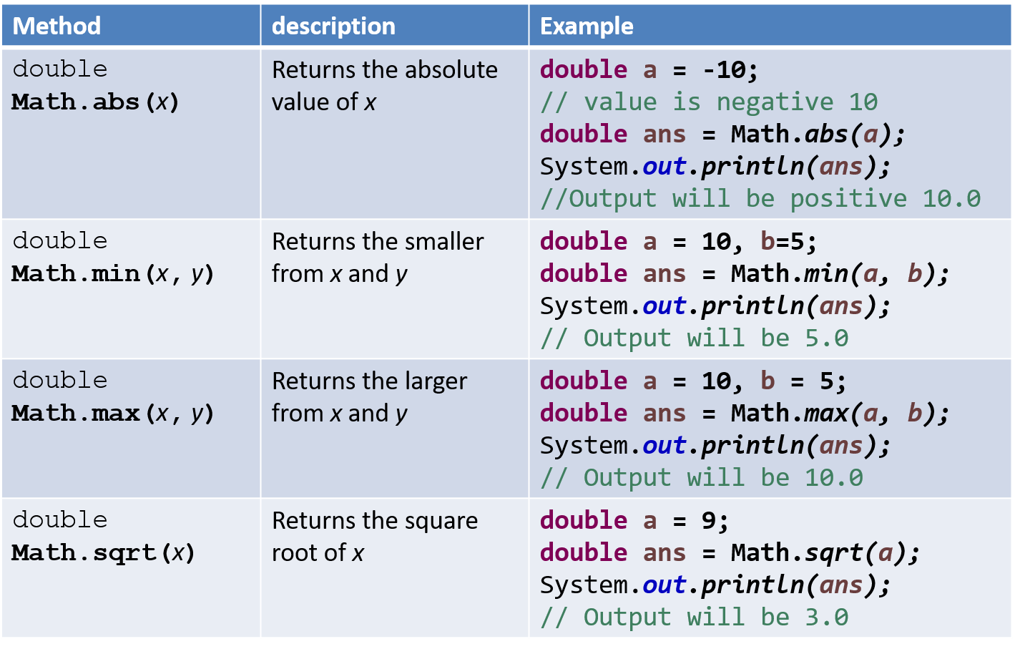
Methods of class Math

Slide 65
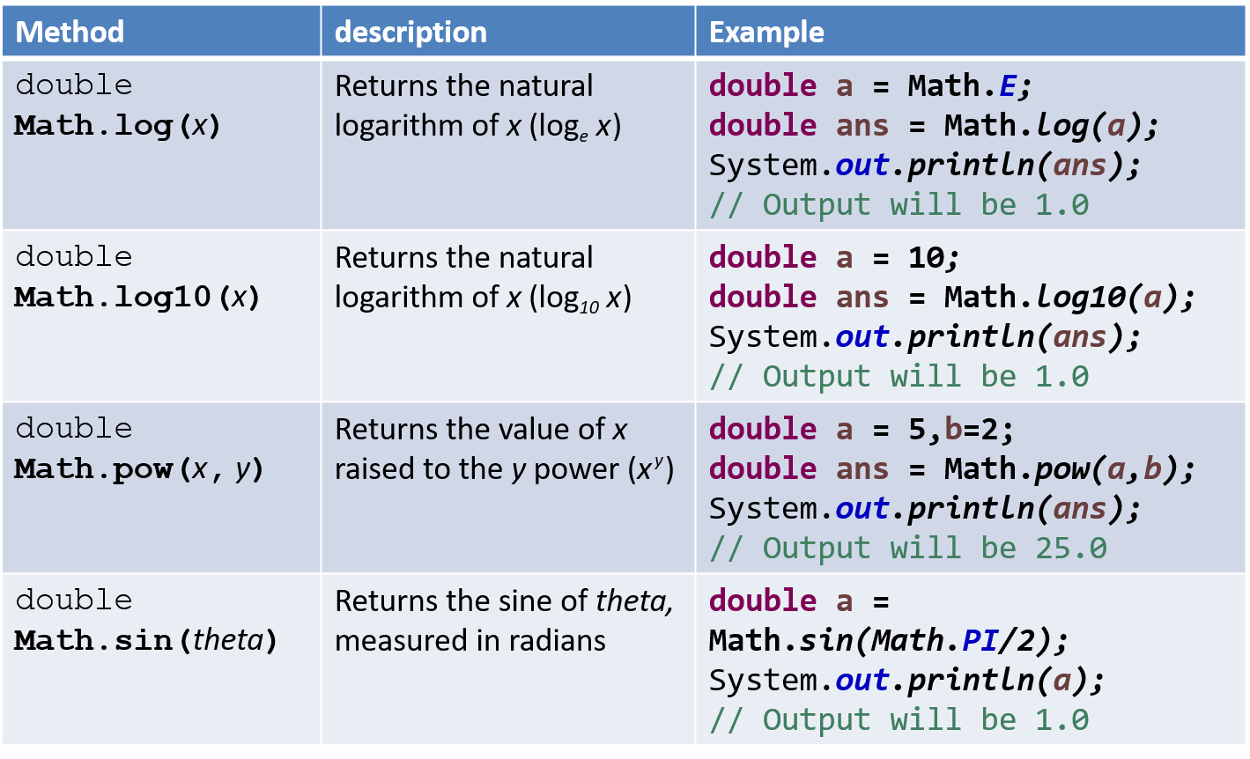
Methods of class Math (Cont.)

Slide 66
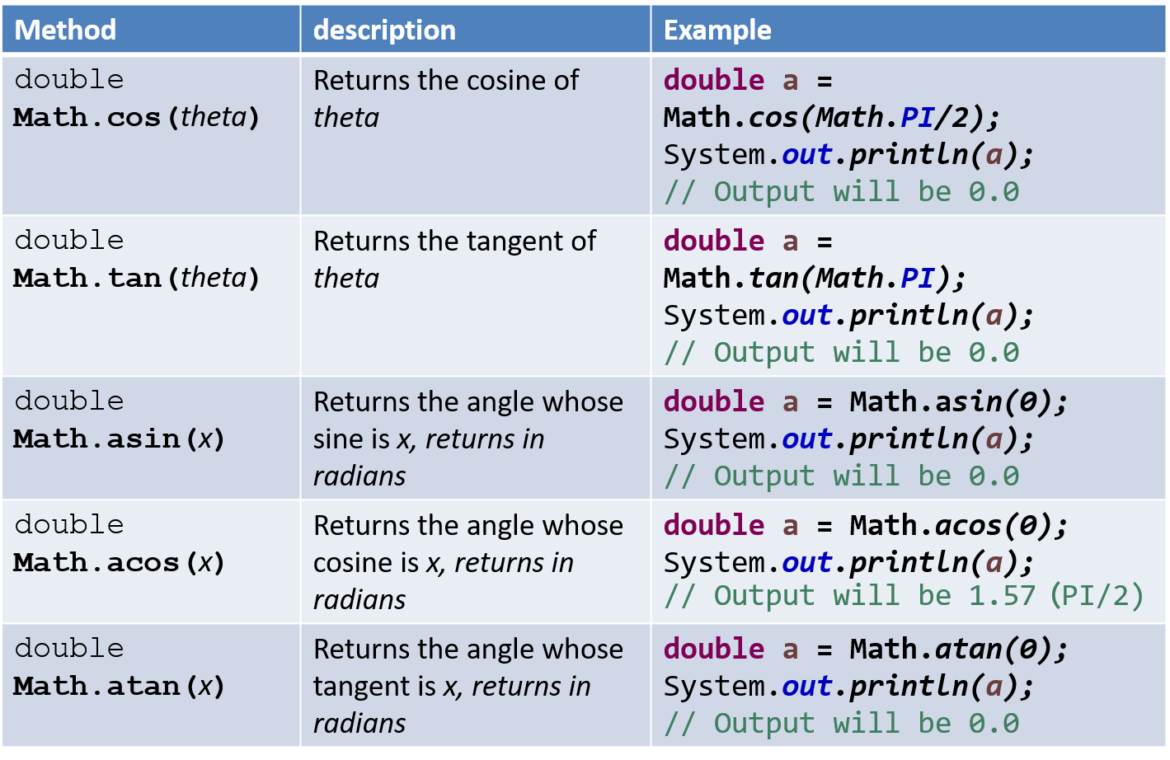
Methods of class Math (Cont.)

Slide 67
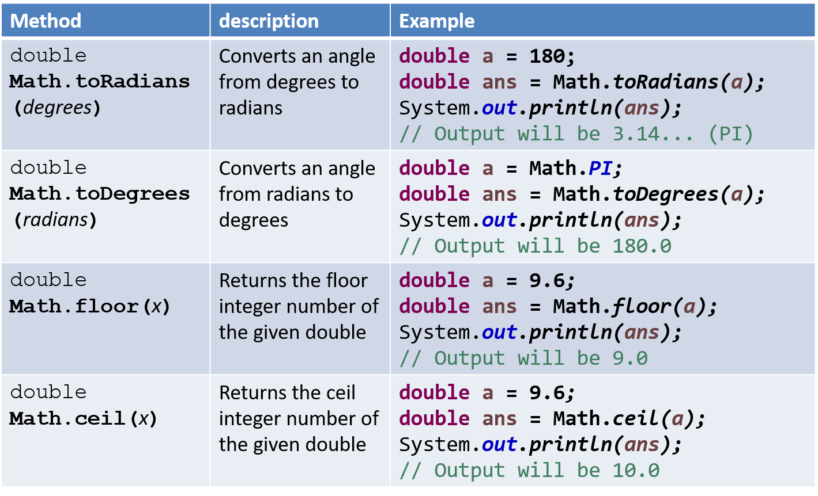
Methods of class Math (Cont.)

Slide 68
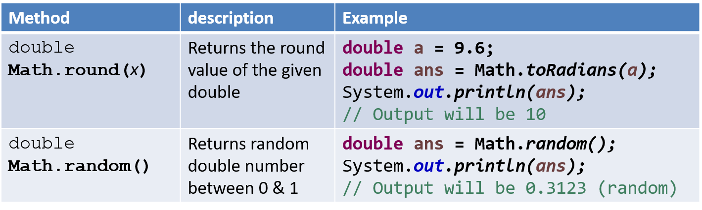
Methods of class Math (Cont.)

Slide 69
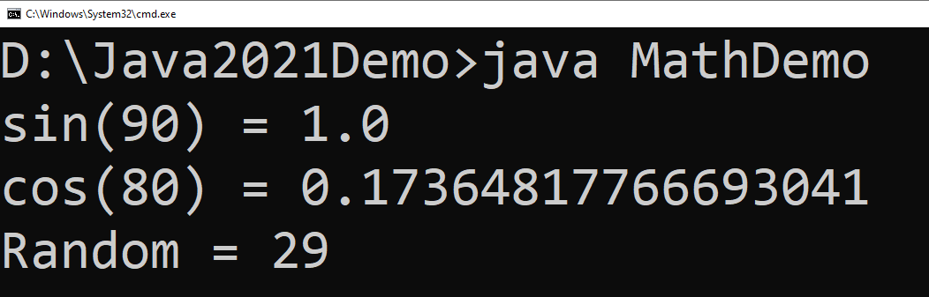
Math Example
public class MathDemo {
public static void main(String[] args) {
double sinValue = Math.sin(Math.PI / 2);
double cosValue = Math.cos(Math.toRadians(80));
int randomNumber = (int)(Math.random() * 100);
// values in Math class must be given in Radians
// (not in degree)
System.out.println("sin(90) = " + sinValue);
System.out.println("cos(80) = " + cosValue);
System.out.println("Random = " + randomNumber);
}
}

Slide 70
Wrapper classes
A Wrapper class is a class whose object wraps or contains a primitive datatypes.
When we create an object to a wrapper class, it contains a field and in this field, we can store a primitive datatypes.
In other words, we can wrap a primitive value into a wrapper class object.
Use of wrapper class :
They convert primitive datatypes into objects.
The classes in java.util package handles only objects and hence wrapper classes help in this case also.
Data structures in the Collection framework, such as ArrayList and Vector, store only objects (reference types) and not primitive types.
An object is needed to support synchronization in multithreading.

Slide 71
Wrapper classes (Cont.)
Primitive datatype | Wrapper class | Example
byte | Byte | Byte b = new Byte((byte) 10);
short | Short | Short s = new Short((short) 10);
int | Integer | Integer i = new Integer(10);
long | Long | Long l = new Long(10);
float | Float | Float f = new Float(10.0);
double | Double | Double d = new Double(10.2);
char | Character | Character c = new Character('a');
boolean | Boolean | Boolean b = new Boolean(true);
Common Fields (Except Boolean):
MIN_VALUE : will return the minimum value it can store.
MAX_VALUE : will return the maximum value it can store.

Slide 72
Parsing the String
Using wrapper class we can parse string to any primitive datatype (Except char).
byte b1 = Byte.parseByte("10");
short s = Short.parseShort("10");
int i = Integer.parseInt("10");
long l = Long.parseLong("10");
float f = Float.parseFloat("10.5");
double d = Double.parseDouble("10.5");
boolean b2 = Boolean.parseBoolean("true");
char c = Character.parseCharacter('a');
Note : for Integer class we have parseInt not parseInteger

Slide 73
BigInteger and BigDecimal
The BigInteger class found in java.math package is used for mathematical operation which involves very big integer calculations that are outside the limit of all available primitive data types.
For example factorial of 100 contains 158 digits in it so we can’t store it in any primitive data type available.
There is no theoretical limit on the upper bound of the range because memory is allocated dynamically
The BigDecimal class found in java.math package provides operation for arithmetic, comparison, hashing, rounding, manipulation and format conversion.
This method can handle very small and very big floating point numbers with great precision.
import java.math.BigInteger;
public class DemoBigNumbers {
public static void main(String[] args) {
BigInteger bi = new BigInteger("1234567891234567891234567890");
System.out.println(bi); // will return 1234567891234567891234567890
}
}
BigDecimal bd = new BigDecimal("111111.000000000000000000025");
System.out.println(bd); //111111.000000000000000000025

Slide 74
Programs
Write a class named Rectangle to represent a rectangle. It contains following members: Data: width (double) and height (double) that specify the width and height of the rectangle. Methods: 1. A no-arg constructor that creates a default rectangle. 2. A constructor that creates a rectangle with the specified width and height. 3. A method named getArea() that returns the area of this rectangle. 4. A method named getPerimeter() that returns the perimeter.
Write a program to create circle class with area function to find area of circle.
Define time class with hour and minute. Also define addition method to add two time objects.
Declare a class called student having following data members:id_no, no_of_subjects_registered, subject_code, subject_credits, grade_obtained and spi. Define constructor and calculate_spi methods. Define main to instantiate an array for objects of class student to process data of n students.

